Slide 1

UNIX Workshop: Practical Guide to the Command Line
AAFC Bioinformatics Conference and Workshop
September 19-20, 2019, Lethbridge, Alberta
Miles Buchwaldt
Biology Study Leader – Bioinformatics, Saskatoon RDC
19 Sept. 2019

Slide 2
The Goal of this Workshop
Introduce the fundamental concepts of working in UNIX environments
Beginners will acquire the basics and some exposure to UNIX
Experienced users might learn a trick or two
Independent study and practice will be required to become effective
https://redmine.biodiversity.agr.gc.ca/projects/biocluster/wiki/Biocluster_User_Guide

Slide 3
Table of Contents
1. Basic Commands
2. Input & Output
3. The Environment
4. Non-standard Software
5. Regular Expressions
6. Scripting

Slide 4
Initial Setup
Create a secure shell on the remote server:
$ ssh bctraining###@biocluster.agr.gc.ca
Type your password at the prompt:
There will be no indication that characters are being entered for security purposes
Acquire access to a worker node:
[bctraining###@biocomp-0-3 ~]$ qlogin

Slide 6
What is the command line?
User interface, where a user can issues “commands” to the computer carry out various tasks.
Commands follow a strict format:
$ <command> <options> <arguments>
<command>: an executable file on the system
<options>: flags that change the default behavior of the program
<arguments>: information the program requires to carry out it’s task

Slide 7
Locating Files and Directories
Where am I?
$ pwd
What is around me?
$ ls
How do I leave this place?
$ cd [path/to/directory]

Slide 8
Paths – Relative vs Absolute
Relative path: specifies the path from your current location to the file
Current directory can be referenced with: “./”
One directory up: “../”
Absolute path: specifies the path to the file relative to the base root directory
Begins with “/”

Slide 9
Create, Move, Delete Files
Creating files:
$ touch <filename>
Copying/Moving files:
$ cp <source> <destination>
$ mv <source> <destination>
Deleting files:
$ rm
* Note: mv is also used to rename files

Slide 10
Reading File Contents
Print a file:
$ cat <filename>
Print the top/bottom of a file:
$ head <filename>
$ tail <filename>
View paginated version:
$ less <filename>

Slide 11
Editing Text Files
Commandline text editors will be available
Vi, vim, nano, emacs
Do not operate the same as a GUI based text editor
Mouse cannot move cursor position, nor can it navigate menus
Hotkeys are used for everything
Sometimes involve different editor states

Slide 12
Options
Alter the behavior of commands
Find appropriate options via the manual pages
$ man <command>
Commands usually output usage information when given -h, --help or no arguments:
$ samtools --help

Slide 13
Options – Useful Examples
Copy move or delete directories:
$ cp|mv|rm -r <directory>
More detailed directory listing with ls:
-l long listing: shows more information
-a all files: includes hidden files
-h human readable file sizes

Slide 14
File Permissions
Three types of permissions that apply to 3 subsets of users
Altered with chmod command
$ chmod rwxrwxrwx <filename>
Owner
Group
World
 | Owner | Group | World
Read | 4-- | -4- | --4
Write | 2-- | -2- | --2
Execute | 1-- | -1- | --1

Slide 15

Input and Output
Text Streams
Redirection
Pipes

Slide 16
Text Streams
Text streams are blocks of characters, usually separated by newlines that a program uses to communicate with it’s environment
STDIN (file descriptor: 0)
STDOUT (file descriptor: 1)
STDERR (file descriptor: 2)
Most commands take input from STDIN, output to STDOUT and if there are errors, send error information to STDERR
Notes:
Fundamentally, everything in UNIX operates on text

Slide 17
Redirection
These three text streams can be redirected to each other, or to files
Redirect STDIN (read from file)
$ cat < text.txt
Redirect STDOUT
$ cat text.txt > copyOfText.txt
$ cat text.txt >> textTwice.txt (append)
Redirect STDERR
$ cat text.txt 2> errorsText.txt
$ cat text.txt 2>&1 outputAndErrors.txt

Slide 18
Pipes
Another form of redirection:
STDOUT of one command is sent to STDIN of another command
Used to “chain” commands together
$ grep “^$” data.txt | wc -l
$ history | grep “java”
$ tar -tzv Tarball.tar.gz | less
Notes:
Pipes are what give UNIX systems it’s power. The possibilities are only limited by the user’s creativity and knowledge of available commands.

Slide 19

The Environment
Do you think those are buttons you are clicking? Do you honestly think that your mouse has any effect on your commands, in here?
Variables
Permissions
Important Directories

Slide 20
Where do commands go?
The “interpreter”, sh, bash, perl, python
Variables:
$PATH, $HOME, $USER
Print a variable’s contents with:
$ echo <$VARIABLE>
Set a variable with:
$ export VARIABLENAME=“New value”
Add executable to path:
$ export PATH=$PATH:/path/to/file

Slide 21
Variables
Some software has prerequisite packages, libraries, modules.
These are found using variables containing the path to the required files:
$LD_LIBRARY_PATH
$PERL5LIB
$LIBPATH
To get a list of the current variables:
$ printenv

Slide 22
Environment Setup
When you connected to the BioCluster with “ssh” the commands in ~/.bashrc, ~/.bash_profile are executed
Edit these files with a text editor
Must restart shell session, or source the files before changes come into effect:
$ source ~/.bash_profile
$ . ~/.bashrc

Slide 23

Software
READ THE DOCUMENTATION! You can usually find it in INSTALL.txt, README.*, the GitHub page, the wiki, or with a google search.
Installation
Execution
Troubleshooting

Slide 24
Installing New Programs (via git)
Download a git repository
$ git clone https://github.com/lh3/bwa.git
Look out for special instructions that pertain to you
Likely a local installation!
$ ./configure --prefix=~/bin

Slide 25
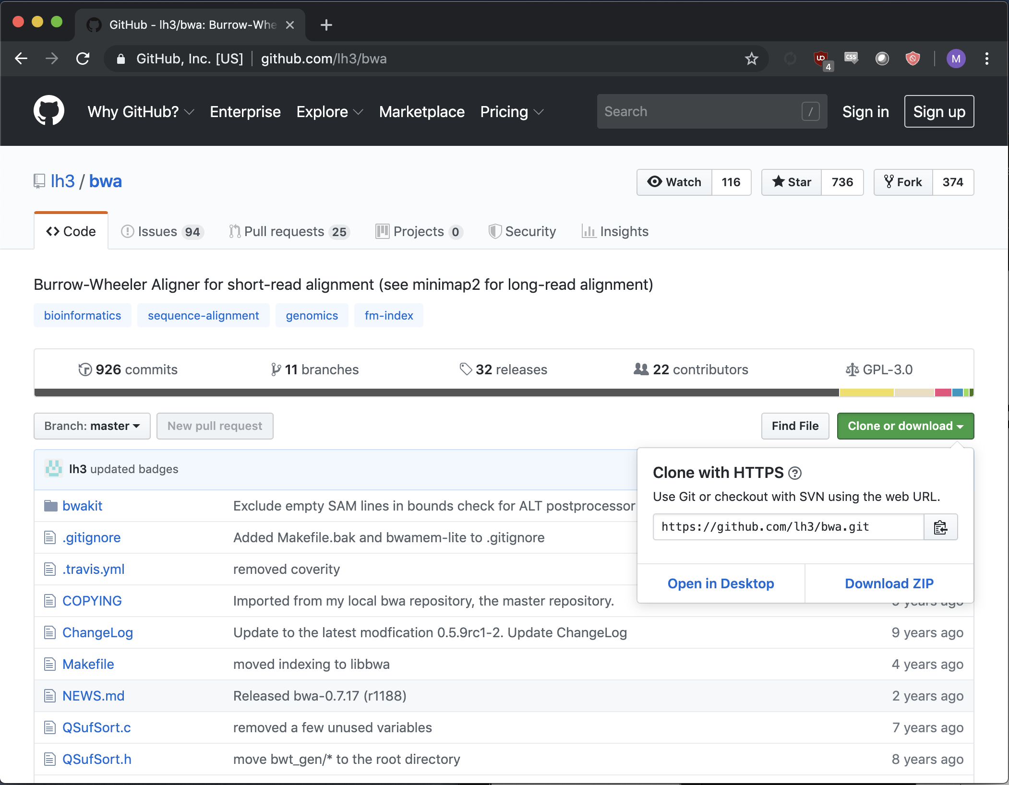
To get github link:
CLICK THIS

Slide 26
Make and Makefiles
./configure [--prefix=~/bin]
make
make install
Look out for errors in the above and Read Them
Most likely causes for compilation errors are missing or incompatible version of dependencies.

Slide 27
Add To Path
To use a new command without specifying the relative/absolute path to it each time:
$ export PATH=$PATH:/path/to/command
Or add to ~/.bash_profile or ~/.bashrc
$ source ~/.bash_profile
$ which command

Slide 28

Dependencies
Instructions for software requirements usually come before installation instructions.
Some dependencies will require administrative priviledges (superuser)
Libraries, compiler versions
These can often be overcome with virtual environments
Some dependencies can be installed by the user as long as the required version is specified in environment variables.

Slide 29
Conda Environments
Create environments
$ conda create --name <ENVNAME>
Enter and exit the environment
$ conda activate <ENVNAME>
$ conda deactivate
List environments
$ conda info --envs

Slide 30
Conda Installations
Search for packages
$ conda search star
Install a package (to current environment)
$ conda install star

Slide 31
Running Software
Read Documentation: README.txt, README.md, etc.
$ <command> <options> <arguments>
$ java -jar path/to/software.jar <options> <arguments>
$ ./script.[sh|pl|py] <arguments>
Make sure you understand what the command will do before you press enter!

Slide 32
Monitoring Jobs
Display active processes:
top
View a certain process, or find one:
ps
End a process (send a signal):
kill

Slide 33
Regular Expressions
Anchors
Wildcards
Quantifiers
Examples

Slide 34
Anchors, Wildcards
Anchors (always use these if possible)
^ → beginning of a string
$ → end of a string
Wildcards are characters that have special meaning to the interpreter
. → any character
[abc0123456789] → any character in a list
[a-zA-Z0-9] → any character in a range
[^ATCG] → any character NOT in a list

Slide 35
Quantifiers
Can specify how many times a character set can be matched
* → 0 or more times
\{n,m\} → at least n times, no more than m times\
\{n,\} → at least n times
\{n\} → exactly n times
These only work when following a character set

Slide 36
Regex extended
There are different flavours of regular expressions
Basic
Extended
Perl extended (includes predefined character sets: \w, \W, \s, \S etc.)
Extended: extra modifiers, and replaces \{, \} with {, }

Slide 37
Shell Scripts
Variables
Conditionals
Loops

Slide 38
Scripts
Are “interpreted” sets of instructions to control other programs
Differ from “compiled” software
Good for automating small, repetitive tasks.
Notes:
Interpreted -> not compiled

Slide 39
Shebang line
Specifies the interpreter that will parse your script
Can use absolute path:
#!/bin/bash
Better to use env as other systems may not have the same bash location
#!/usr/bin/env bash

Slide 40
Arguments
Allows the user to give contextual information to the program
Arguments are stored in special variables:
$1, $2, $3 … etc.
* NOTE: This approach makes assumptions about the order and format of arguments

Slide 41
Other Special Variables
$0 -> filename of current script
$$ -> PID
$# -> number of arguments
$? -> exit status of last command
$! -> PID of last background command

Slide 42
Variables
Created using an assignment statement (no spaces)
MYVAR=“abc123”
Arrays specified by brackets separating elements with spaces
MYARRAY=(a b c 1 2 3)

Slide 43
Output
Either with echo:
echo $MYVAR
> abc123
Or the more robust printf
printf <formatString> <arguments>
printf “%s\n” $MYVAR
> abc123

Slide 44
Conditionals
Run a code segment only if a condition is satisfied
Useful for specific tasks, and also to avoid error states

Slide 45
Loops
Run a code segment multiple times
Common pitfalls:
Infinite loops
Off-by-one errors
Different types:
For loops
While loops
Recursion (too complicated for this workshop and rarely required)

Slide 46
Functions
Isolated pieces of code that should carry out a singular function
Useful for tasks that are done frequently
Also aid readability and organization of scripts

Slide 47
Scripting Best Practices

Slide 48
Best Practices
Formatting:
Variables, functions and commands should be distinct
CAPITAL_AND_UNDERSCORES
camelCaseFormat or CamelCaseFormat
lowercase_and_underscores
However you choose to distinguish these is fine, just be consistent.

Slide 49
Arguments
Can eliminate assumptions made for argument format and order using case

Slide 50
VARIABLEONE=“/path/to/file1.txt”
VARIABLETWO=“/path/to/file2.txt”
while [ $# -gt 0 ]; do
case “$1” in
-v1|--variable1)
VARIABLEONE=“$2”
shift 2
;;
-v2|--variable2)
VARIABLEONE=“$2”
shift 2
;;
*)
break
;;
esac
done
# Some simple argument checks
wrong_arg() {
echo "Error: invalid value for $1" >&2
exit 2
}
[ -f $IN_FILE ] || wrong_arg "input file"
[ -f $OUT_FILE ] || wrong_arg "output file"

Slide 51
Debugging
Using the ”set” builtin, can activate debugging mode:
set -x
Prints all command executions and variable changes
set -euo pipefail
Exit when commands fail, var references are not declared and when pipes fail

